Slide 1
Introduction to Unix: Fundamental Commands

Slide 2

What You Will Learn
The fundamental commands of the Unix operating system.
Everything told for Unix here is applicable to the Linux operating system also.

Slide 3
What Is UNIX?
UNIX is a computer operating system, a control program that works with users to
run programs,
manage resources, and
communicate with other computer systems.
Several people can use a UNIX computer at the same time; hence UNIX is called a multiuser system. Any of these users can also run multiple programs at the same time; hence UNIX is called multitasking.

Slide 4
Shell Commands of UNIX
Unix Commands
When you first log into a unix system, you are presented with something that looks like the following:
/home/larry#
That “something” is called a prompt. As its name would suggest, it is prompting you to enter a command.
Every unix command is a sequence of letters, numbers and characters. But there are no spaces.

Slide 5
Unix is also case-sensitive. This means that cat and Cat are different commands.
The prompt is displayed by a special program called the shell.
Shells accept commands, and run those commands.
They can also be programmed in their own language. These programs are called “shell scripts”.

Slide 6
There are two major types of shells in unix:
Bourne shells
C shells.
Steven Bourne wrote the original unix shell sh, and most shells since then end in the letters sh to indicate they are extentions on the original idea
Linux comes with a Bourne shell called bash written by the Free Software Foundation.
bash stands for Bourne Again Shell and is the default shell to use running linux

Slide 7
When you first login, the prompt is displayed by bash, and you are running your first unix program, the bash shell.
As long as you are logged in, the bash shell will constantly be running.

Slide 8
obtaining help
Unix Commands
The man command displays reference pages for the command you specify.
The UNIX man pages (man is short for manual ) cover every command available.
To search for a man page, enter man followed by the name of the command to find .
For example:
bagriy@sariyer:~> man ls

Slide 9
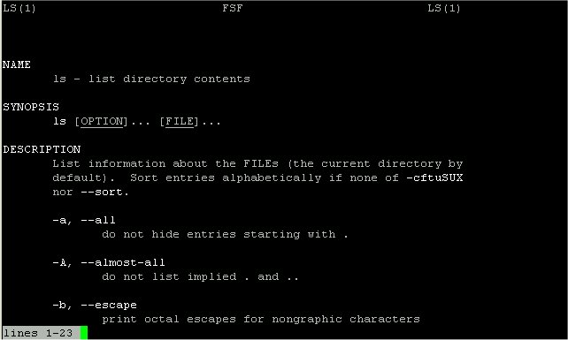
To exit
Press “q”

Slide 10

cat
cat command is used to concatenate or displays the contents of a file.
To use it, type cat, and then press enter key:
/home/larry# cat
This produces the correct result and runs the cat program.
Prompt
Command
İf you type this row and then press enter
The text indicates what we typed to cat
To end many unix command, type end-of-file command (EOF) [hold down the key labeled “Ctrl” and press “d” (Ctrl+d) ]

Slide 11
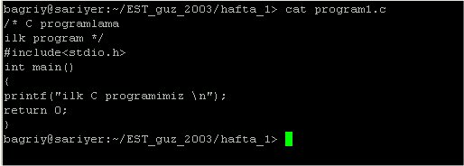
To display the contents of a file, type
cat filename

Slide 12
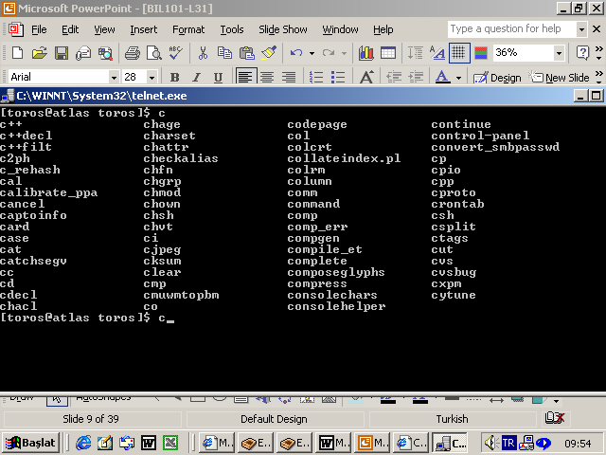
To see linux commands press Tab key,
If you want to learn commands beginning with c you can write c then press Tab key
/home/larry# c

Slide 13
Storing information
Unix provides files and directories.
A directory is like a folder: it contains pieces of paper, or files.
A large folder can even hold other folders-directories can be inside directories.
In unix, the collection of directories and files is called the file system. Initially, the file system consists of one directory, called the “root” directory
Inside “root” directory, there are more directories, and inside those directories are files and yet more directories.

Slide 14
Each file and each directory has a name.
A short name for a file could be joe,
while it’s “full name” would be /home/larry/joe. The full name is usually called the path.
The path can be divide into a sequence of directories.
For example, here is how /home/larry/joe is read:
/home/larry/joe
The initial slash indicates the root directory. This signifies the directory called home. It is inside the root directory.
The second slash corresponds to the
directory larry, which is inside home.
joe is inside larry.

Slide 15
A path could refer to either a directory or a filename, so joe could be either.
All the items before the short name must be directories.
Root Directory
Directory
Directory
home
Sub-Directory
larry
Directory structure
File
File
joe

Slide 16

Looking at directories with Is
The command ls lists files.
If you try ls as a command, you’ll see:
/home/larry# ls
/home/larry#
That is right, you will see nothing.
If you have files, ls lists the names of files in the directory

Slide 17
If you want a list of files of a more active directory, try the root directory.
/home/larry# ls /
bin etc install mnt root user var
dev home lib proc tmp usr vmlinux
“/” is a parameter saying what directory you want a list for.
Some commands have special parameters called options or switches. To see this try:
/home/larry# ls –F /
bin etc/ install/ mnt/ root/ user/ var/
dev/ home/ lib/ proc/ tmp/ usr/ vmlinux/
The -F is an option. It displays file types.

Slide 18
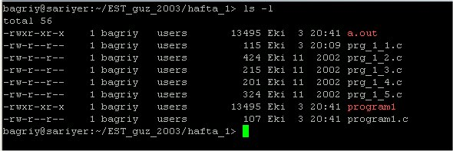
An option is a special kind of parameter that starts with a dash “-”
An option modifies how the program runs, but not what the program runs on.
For ls, -F is an option that lets you see which ones are directories, which ones are special files, which are programs, and which are normal files.
Anything with a slash “/” is a directory.
ls -l file* displays files starting with “file”
ls –l displays all details

Slide 19
Many unix commands are like ls.
They have options, which are generally one character after a dash, and they have parameters.
Unlike ls, some commands require certain parameters and/or options. You have to learn these commands.

Slide 20
passwd
With the passwd command, you can change the password associated with your individual account name.
For example,
sariyer:~> passwd
Changing password for dag.
Old password:
New passwd:
Retype new passwd:
sariyer:~>

Slide 21
pwd
pwd (present working directory) tells you your current directory.
Most commands act, by default, on the current directory. For instance, ls without any parameters displays the contents of the current directory.
cd
cd is used to change directories.
The format of this command :
cd new-directory (where new-directory is the name of the new directory you want).

Slide 22
For instance, try:
/home/larry# cd /home
/home#
If you omit the optional parameter directory, you’re returned to your home, or original directory. Otherwise, cd will change you to the specified directory.
There are two directories used only for relative pathnames:
The directory “.” refers to the current directory
The directory “..” refers to the parent directory
These are “shortcut” directories.
The directory “..” is most useful in “backing up”:
/usr/local/bin# cd ..
/usr/local#

Slide 23
mkdir
mkdir (make directory) is used to create a new directory,
It can take more than one parameter, interpreting each parameter as another directory to create.
rmdir
rmdir (remove directory) is used to remove a directory,
rmdir will refuse to remove a non-existant directory,
as well as a directory that has anything in it.

Slide 24
Moving Information
The primary commands for manipulating files under unix are cp, mv, and rm. They stand for copy, move, and remove, respectively.
cp
cp is used to copy contents of file1 to file2
cp file1 file2 (contents of file1 is copied to file2 in the same directory)
cp folder1/file1 folder2 (contents of file1 is copied to file1 in the inside of folder2 directory)

Slide 25
rm
rm is used to remove a file.
rm filename ---> removes a file named filename
mv
mv is used to move a file.
rm filename ---> removes a file named filename
looks like cp, except that it deletes the original file after copying it.
mv will rename a file if the second parameter is a file. If the second parameter is a directory, mv will move the file to the new directory, keeping it’s shortname the same.

Slide 26
Some Other UNIX Commands
The Power of Unix
The power of unix is hidden in small commands that don’t seem too useful when used alone, but when combined with other commands produce a system that’s much more powerful, and flexible than most other operating systems.
The commands include sort, grep, more, cat, wc, spell, diff, head, and tail.

Slide 27
Operating on Files
In addition to the commands like cd, mv, and rm, you learned in shell section, there are other commands that just operate on files, but not the data in them.
These include touch, chmod, du, and df.
All of these files don’t care what is in the file.

Slide 28
Some of the things these commands manipulate:
The time stamp: Each file has three dates associated with it. These are creation time, last modification time and last access time.
The owner: the owner of files
The group: the group of users
The permissions: read, write, execute permissions of files. The permissions tell unix who can access what file, or change it, or, in the case of programs, execute it. Each of these permissions can be toggled separately for the owner, the group, and all the other users.

Slide 29
drwxr-xr-x 2 dag users 6 Dec 6 2000 netscape
file name
owner
group
others
read, write, execute permissions of files
touch
touch will update the time stamps of the files listed on the command line to the current time.
If a file doesn’t exist, touch will create it.

Slide 30
chmod
Chmod (change mode) is used to change the permissions on a file.
(owner) (group) (others)
chmod [number][number][number] file1
Number = (read)4 + (write)2 + (execute)1
Example: Chmod 754 file1
for owner: read, write and execute permissions (4+2+1)
for group: read and execute permissions (4+0+1)
for others: only read permission (4+0+0)

Slide 31
System Statistics
Commands in this section will display statistics about the operating system, or a part of the operating system.
du
du (disk usage) will count the amount of disk space for a given directory, and all its subdirectories take up on the disk.
df
df (disk filling) summarizes the amount of disk space in use.
For each file system, it shows the total amount of disk space, the amount used, the amount available, and the total capacity of the file system that’s used.

Slide 32
uptime
It prints the amount of time the system has been “up”—the amount of time from the last unix boot
uptime also gives the current time and the load average. The load average is the average number of jobs waiting to run in a certain time period.
who
Displays the current users of the system and when they logged in.
If given the parameters am i (as in: who am i), it displays the current user.

Slide 33
What’s in the File?
There are two major commands used in unix for listing files, cat, and more.
cat
cat shows the contents of the file.
cat [-nA] [file1 file2 . . . fileN]
cat is not a user friendly command-it doesn’t wait for you to read the file, and is mostly used in conjuction with pipes.
However, cat does have some useful command-line options. For instance, n will number all the lines in the file, and A will show control characters.

Slide 34
more
more is much more useful, and is the command that you’ll want to use when browsing ASCII text files
more [-l] [+linenumber}] [file1 file2 ... fileN]
The only interesting option is l, which will tell more that you aren't interested in treating the character Ctrl-L} as a ``new page'' character. more will start on a specified linenumber.
head
head will display the first ten lines in the listed files.
head [- lines}] [l file1 file2 ... fileN]
Any numeric option will be taken as the number of lines to print, so head -15 frog will print the first fifteen lines of the file frog

Slide 35
tail
Like head, tail display only a fraction of the file.
tail also accepts an option specifying the number of lines.
tail [-lines] [l file1 file2 ... fileN]
file
file command attempts to identify what format a particular file is written in.
file [file1 file2 ... fileN]
Since not all files have extentions or other easy to identify marks, the file command performs some rudimentary checks to try and figure out exactly what it contains.

Slide 36
Information Commands
The commands that will alter a file, perform a certain operation on the file, or display statistics on the file.
grep
grep is the generalized regular expression parser.
This is a fancy name for a utility which can only search a text file.
grep [-nvwx] [-number] { expression} [file1 file2 ... fileN]

Slide 37
wc
wc (word count) simply counts the number of words, lines, and characters in the file(s).
wc [-clw] [file1 file2 ... fileN]
The three parameters, clw, stand for character, line, and word respectively, and tell wc which of the three to count.
spell
spell is very simple unix spelling program, usually for American English. spell is a filter, like most of the other programs we’ve talked about.
spell [file1 file2 ... fileN]

Slide 38
cmp
cmp compares two files.
The first must be listed on command line, while the second is either listed as the second parameter or is read in form standard input.
cmp is very simple, and merely tells you where the two files first differ.
cmp file1 [ file2]

Slide 39
diff
One of the most complicated standard unix commands is called diff.
The GNU version of diff has over twenty command line options. It is a much more powerful version of cmp and shows you what the differences are instead of merely telling you where the first one is.
diff file1 file2

Slide 40
gzip [-v#] [file1 file2 ... fileN]
gunzip [-v] [file1 file2 ... fileN]
zcat [{file1 file2 ... fileN]
These three programs are used to compress and decompress data.
gzip, or GNU Zip, is the program that reads in the original file(s) and outputs files that are smaller.
gzip deletes the files specified on the command line and replaces them with files that have an identical name except that they have “.gz” appended to them.

Slide 41
tr
The “translate characters” command operates on standard input-it doesn’t accept a filename as a parameter.
Instead, it’s two parameters are arbitrary strings.
It replaces all occurences of string1 in the input string2.
In addition to relatively simple commands such as tr frog toad, tr can accept more complicated commands.
tr string1 string2

Slide 42
Editors
There are a lot of available editors under linux operating system.
Amongst these vi is the most common one. One can claim that every unix system has vi.
The other famous editor is emacs which has some artificial intelligence properties.
The mailing facility pine uses the pico editor.
However, perhaps the simplest one of the editors is joe.
joe has a lot of flexible features of emacs and pico beside the user friendliness of the turbo type of editors.

